Slide 1
Module 4

Slide 2
IP protocol, IP addresses, Internet Control Message Protocol (ICMP), Address Resolution Protocol (ARP), Reverse Address Resolution Protocol (RARP), Bootstrap Protocol (BOOTP), Dynamic Host Configuration Protocol (DHCP). Open Shortest Path First(OSPF) Protocol, Border Gateway Protocol (BGP), Internet multicasting, IPv6, ICMPv6.

Slide 3
IP protocol
IP stands for internet protocol.
It is a protocol defined in the TCP/IP model used for sending the packets from source to destination.
The main task of IP is to deliver the packets from source to the destination based on the IP addresses available in the packet headers.
IP defines the packet structure as well as the addressing method .
An IP protocol provides the connectionless service, which is accompanied by two transport protocols, i.e., TCP/IP and UDP/IP, so internet protocol is also known as TCP/IP or UDP/IP.

Slide 4
IP protocol
Internet Protocol is connectionless and unreliable protocol.
It ensures no guarantee of successfully transmission of data.
In order to make it reliable, it must be paired with reliable protocol such as TCP at the transport layer.
The first version of IP (Internet Protocol) was IPv4 defines an IP address as a 32- bit number..
After IPv4, IPv6 came into the market, using 128 bits for the IP address which has been increasingly used on the public internet since 2006

Slide 5
An internet protocol defines two things:
Format of IP packet
IP Addressing system

Slide 6
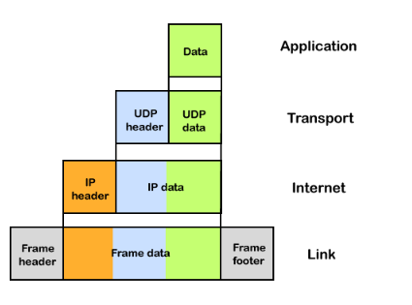
Flow of data

Slide 7
The IP packet format
IP datagram (packet)consists of a header part and a data part
header has a 20-byte fixed part and a variable length optional part

Slide 8
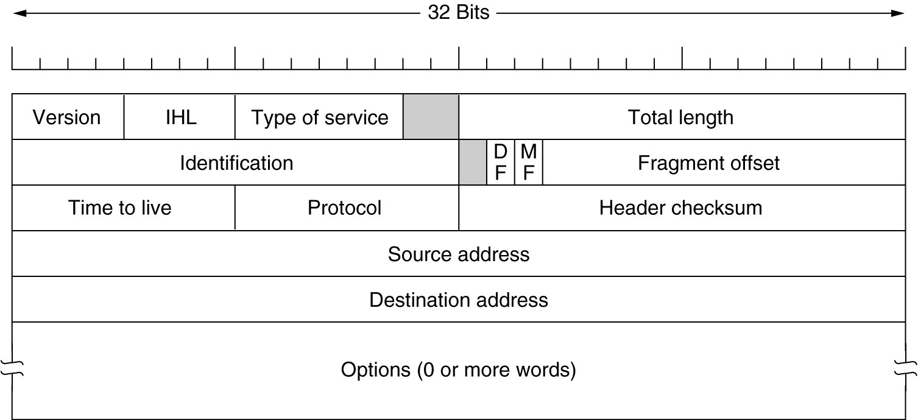
IPV4 Header format

Slide 9
The IP Protocol
Version field
keeps track of which version of the protocol the datagram belongs to.
IHL field
Since the header length is not constant, IHL is provided to tell how long the header is, in 32-bit words.
The minimum value is 5, which applies when no options are present.
The maximum value of this 4-bit field is 15, which limits the header to 60 bytes, and thus the Options field to 40 bytes.

Slide 10
The IP Protocol
Type of service field.
to distinguish between different classes of service
6-bit field contained a three-bit Precedence field and three flags, D, T, and R.
The Precedence field was a priority from 0 (normal) to 7 (network control packet)
The three flag bits allowed the host to specify from the set {Delay, Throughput, Reliability}

Slide 11
The IP Protocol
Total length field
includes everything in the datagram—both header and data.
The maximum length is 65,535 bytes.
Identification field
needed to allow the destination host to determine which datagram a newly arrived fragment belongs to.
If the IP packet is fragmented then each fragmented packet will use the same 16 bit identification number to identify to which IP packet they belong to.
All the fragments of a datagram contain the same Identification value.
Note:
Fragmentation is done by the network layer when the maximum size of datagram is greater than maximum size of data that can be held in a frame

Slide 12
The IP Protocol
two 1-bit fields: DF & MF
DF stands for Don't Fragment.
It is an order to the routers not to fragment the datagram because the destination is incapable of putting the pieces back together again.
MF stands for More Fragments.
– tells if more fragments are ahead of this fragment if MF = 1, and if MF = 0, it is the last fragment.

Slide 13
The IP Protocol
Fragment offset field:
this 13 bit field specifies the position of the fragment in the original fragmented IP packet.
Time to live field
Everytime an IP packet passes through a router, the time to live field is decremented by 1.
Once it hits 0 the router will drop the packet and sends time exceeded message to the sender.
The time to live field has 8 bits and is used to prevent packets from looping around forever. Thus prevents datagrams from wandering around forever

Slide 14
The IP Protocol
Protocol field
this 8 bit field tells us which protocol is encapsulated in the IP packet, for example TCP has value 6 and UDP has value 17.
Header checksum field
verifies the header only.
field is used to store a checksum of the header. The receiver can use the checksum to check if there are any errors in the header.

Slide 15
The IP Protocol
Source IP address: 32 bits IP address of the sender
Destination IP address: 32 bits IP address of the receiver
Options field
Optional information such as source route, record route.
Used by the Network administrator to check whether a path is working or not.
The options are variable length and is not used often.

Slide 16
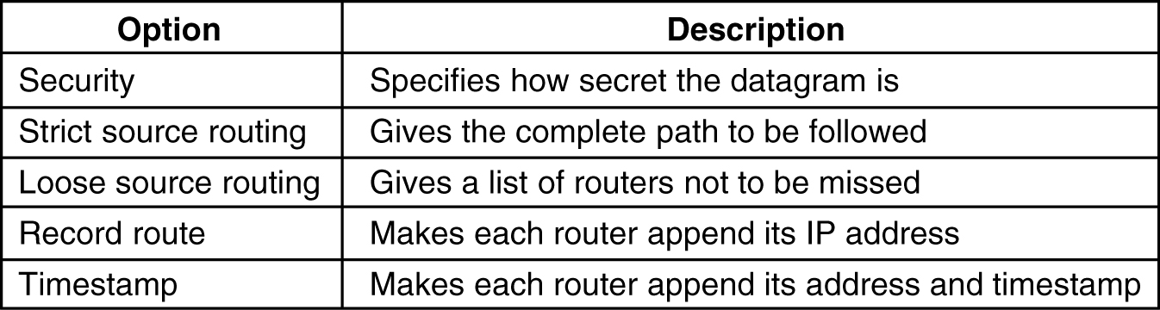
Some of the IP options.

